Slide 1
WDR81-WDR91 in Infection of SARS-CoV-2
School of Pharmacy
University College London
Kangping Liu
Prof. Matthew H. Todd Group

Slide 2
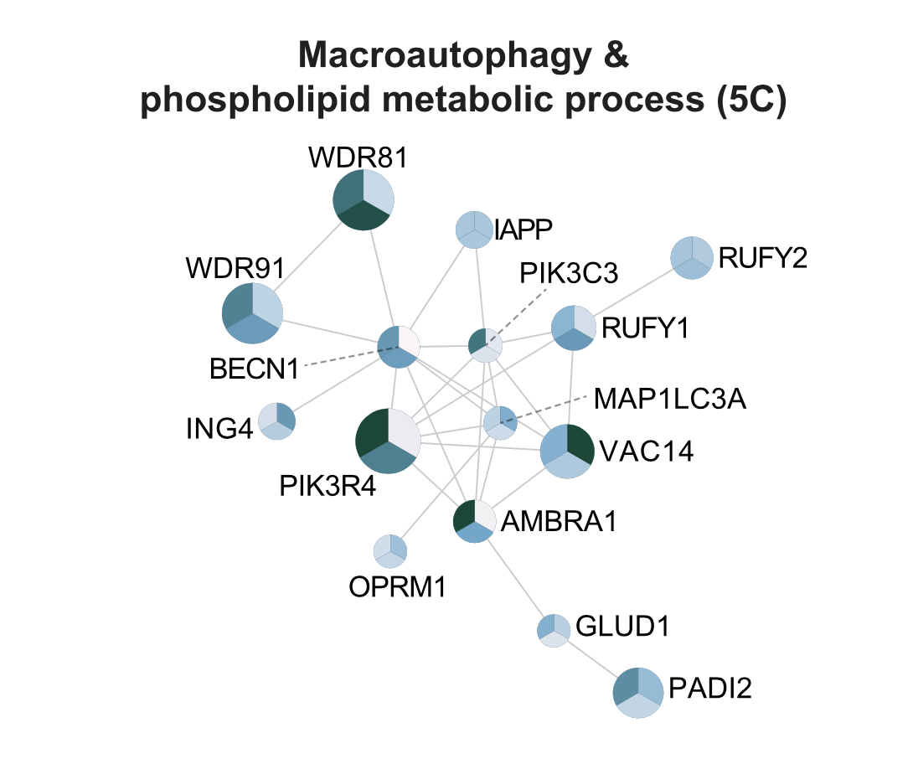
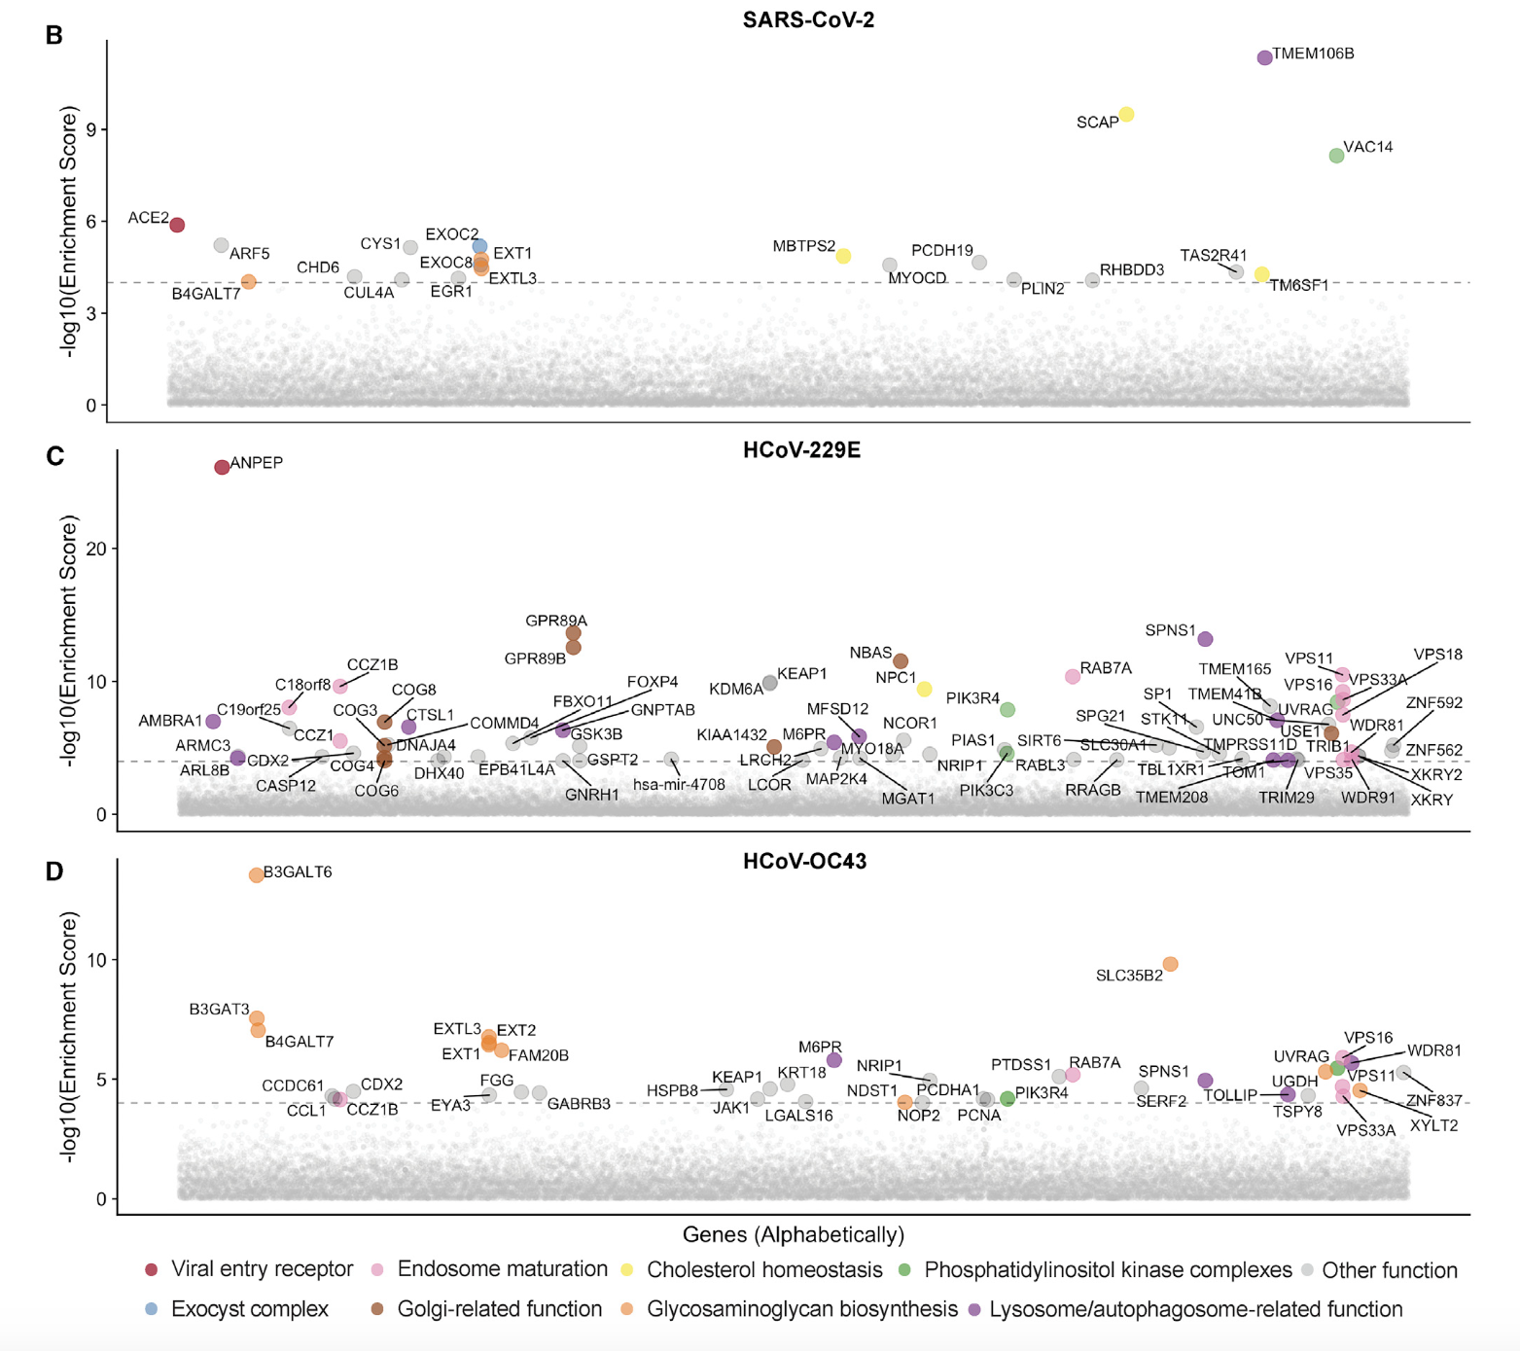
School of Pharmacy
University College London
Gene Screening of WDR81-WDR91 in Virial Infection and Relevance of WDR81-WDR91
Genetic Screens Identify Host Factors for SARS-CoV-2 and Common Cold Coronaviruses, R. Wang, , C. R. Simoneau, J. Kulsuptrakul, M. Bouhaddou, K.A. Travisano, J. M. Hayashi, J. Carlson-Stevermer, J. R. Zenger, C. M. Richards, P. Fozouni, J. Oki, L. Rodriguez, B. Joehnk, K. Walcott, K. Holden, A. Sil, J.E. Carette, N. J. Krogan, M. Ott, M. and A. S.PUSCHNIK, Cell. 2021, 184, 106-119. (DOI: 10.1016/j.cell.2020.12.004)
Notes:
LHS:gene screen related to infection of SARS-CoV-2, 229E and OC43. Relevance between infection of SARS-CoV-2 and WDR81 may not be clear
RHS:Network of neighborhoods across all 3 species and shows WDR81 and WDR91 may work in pair.

Slide 3
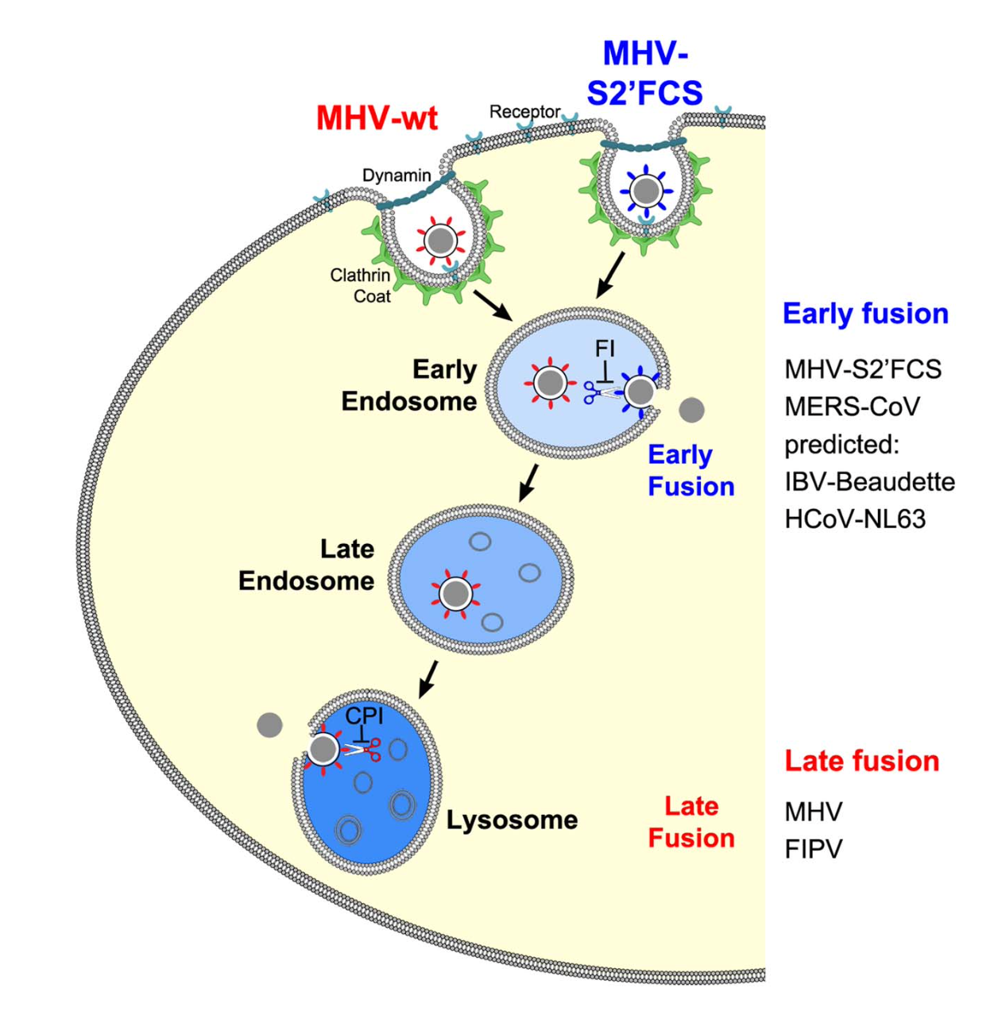
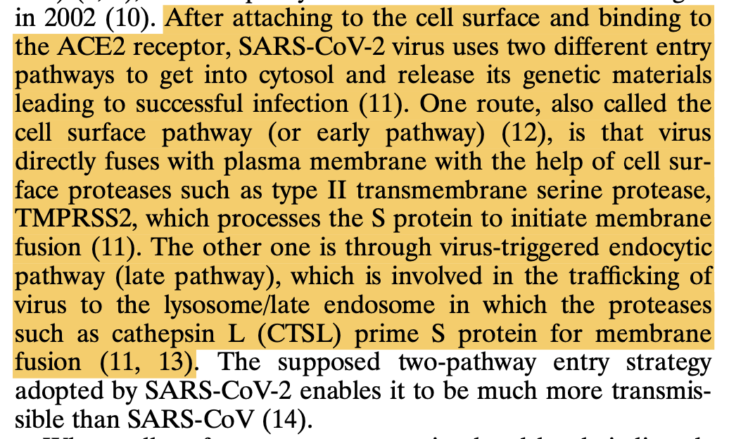
School of Pharmacy
University College London
WDR81-WDR91 in Endo-Lysomomal Pathway of Coronaviruses
WDR81-WDR91 involved
Scheme: Coronavirus Cell Entry Occurs through the Endo-/Lysosomal Pathway in a Proteolysis-Dependent Manner, C. Burkard, M. H. Verheije, O. Wicht, S. I. van Kasteren, F. J. van Kuppeveld, B. L. Haagmans, L. Pelkmans, P. J. Rottier, B. J. Bosch and C. A. de Haan, PLoS. Pathog. 2014, 10, e1004502. (DOI: 10.1371/journal.ppat.1004502)
A Genetic Screen Identifies a Critical Role for the WDR81-WDR91 Complex in the Trafficking and Degradation of Tetherin, R. Rapiteanu, L. J. Davis, J. C. Williamson, R. T. Timms, J. Paul Luzio and P. J. Lehner, Traffic. 2016, 17, 940-958. (DOI: 10.1111/tra.12409)
Text: B. Yang, Y. Jia, Y. Meng, Y. Xue, K. Liu, Y. Li, S. Liu, X. Li, K. Cui, L. Shang, T. Cheng, Z. Zhang, Y. Hou, X. Yang, H. Yan, L. Duan, Z. Tong, C.Wu, Z. Liu, S. Gao, S. Zhuo, W. Huang, G. F. Gao, J. Qing and G. Shang, SNX27 Suppresses SARS-CoV-2 Infection by Inhibiting Viral Lysosome/Late Endosome Entry. Proc. Natl. Acad. Sci. U. S. A. 2022, 119. DOI: 10.1073/pnas.2117576119
Notes:
LHS:WDR81-WDR91 act in the red arrow stage
RHS:SARS-CoV-2 enter the cell via 2 pathways---which one it will take in infection of human or in particular-–human lung cells?

Slide 4
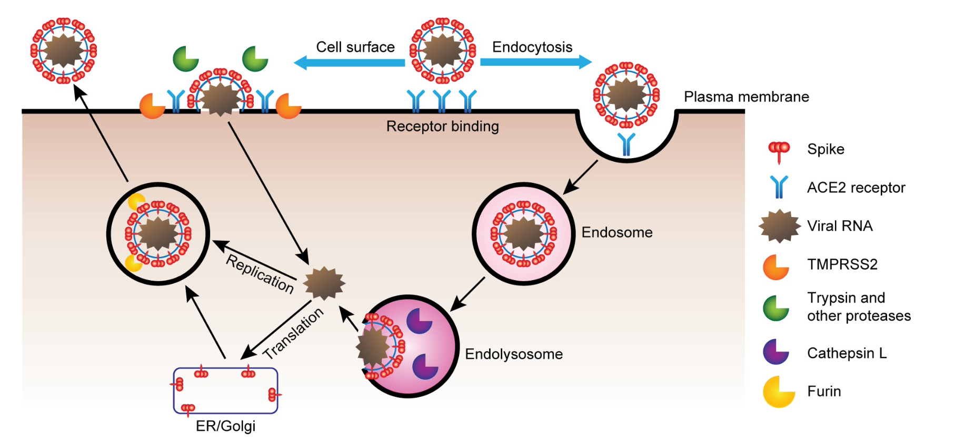
School of Pharmacy
University College London
Cell Entry Pathways of SARS-CoV-2
SARS-CoV-2 Tropism, Entry, Replication, and Propagation: Considerations for Drug Discovery and Development, N. Murgolo, A. G. Therien, B. Howell, D. Klein, K. Koeplinger, L. A. Lieberman, G. C. Adam, J. Flynn, P. McKenna, G. Swaminathan, D. J. Hazuda and D. B. Olsen, PLoS. Pathog. 2021, 17, e1009225. (DOI: 10.1371/journal.ppat.1009225)

Slide 5
School of Pharmacy
University College London
Camostat mesylate
Cathepsin B/L
E-64d
SARS-CoV-2 Cell Entry Depends on ACE2 and TMPRSS2 and Is Blocked by a Clinically Proven Protease Inhibitor, M. Hoffmann, H. Kleine-Weber, S. Schroeder, N. Kruger, T. Herrler, S. Erichsen, T. S. Schiergens, G. Herrler, N. H. Wu, A. Nitsche, M. A. Muller, C. Drosten and S. Pohlmann, Cell. 2020, 181, 271-280 (DOI: 10.1016/j.cell.2020.02.052)

Slide 6
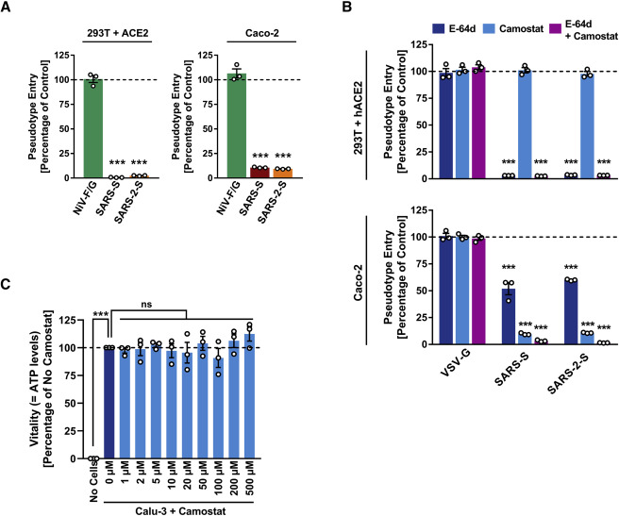
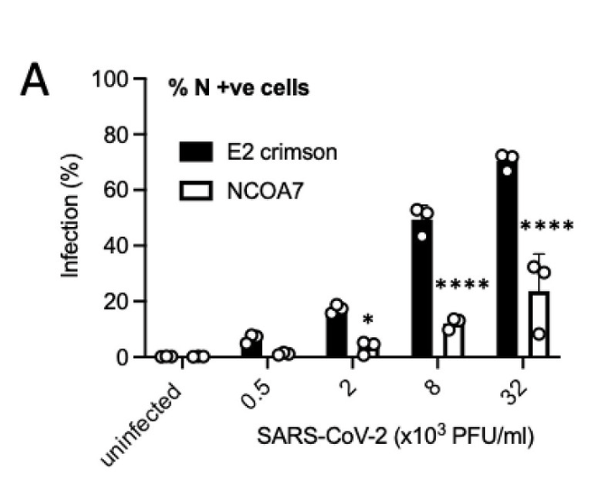
School of Pharmacy
University College London
Confirmation of Presence of Endo-Lysosomal in Human Cells by Infection Decrease
SARS-CoV-2 Cell Entry Depends on ACE2 and TMPRSS2 and Is Blocked by a Clinically Proven Protease Inhibitor, M. Hoffmann, H. Kleine-Weber, S. Schroeder, N. Kruger, T. Herrler, S. Erichsen, T. S. Schiergens, G. Herrler, N. H. Wu, A. Nitsche, M. A. Muller, C. Drosten and S. Pohlmann, Cell. 2020, 181, 271-280 (DOI: 10.1016/j.cell.2020.02.052)
TMPRSS2 Promotes SARS-CoV-2 Evasion from NCOA7-Mediated Restriction, H. Khan, H. Winstone, J. M. Jimenez-Guardeno, C. Graham, K. J. Doores, C. Goujon, D. A. Matthews, A. D. Davidson, S. J. Rihn and M. Palmarini, PLoS. Pathog. 2021, 17, e1009820. (DOI: 10.1371/journal.ppat.1009820)
Notes:
LHS: direct entry inhibited by camostat. Endo-lysosomal pathway is present in Caco-2 (human colon cell).No infection in cells whose endo-lysosomal pathway is shun down by E-64d.
RHS: Endo-lysosomal pathway inhibited by NCOA7, E2 crimson as control group in A549 cells.
Endo-lysosomal pathway confirmed in infection of SARS-CoV-2 in human lung cells

Slide 7
School of Pharmacy
University College London
Endo-Lysosome pathway confirmed in Huh7, Caco-2 & A549 cells
Infection of SARS-CoV-2 can be potentially prevented by inhibiting the WDR81-WDR91
Developmental problems—Inhibition of WDR81 may cause hippocampal dysfunction
Identification of WDR81-WDR91 binding site—C terminal of WDR81

